Slide 1
Basic Business Statistics
12th Edition
Chapter 3
Numerical Descriptive Measures
Chap 3-1

Slide 2
Learning Objectives
In this chapter, you learn:
To describe the properties of central tendency, variation, and shape in numerical data
To construct and interpret a boxplot
To compute descriptive summary measures for a population
To compute the covariance and the coefficient of correlation
Chap 3-2

Slide 3
Summary Definitions
DCOVA
The central tendency is the extent to which all the data values group around a typical or central value.
The variation is the amount of dispersion or scattering of values
The shape is the pattern of the distribution of values from the lowest value to the highest value.
Chap 3-3

Slide 4
Measures of Central Tendency:
The Mean
DCOVA
The arithmetic mean (often just called the “mean”) is the most common measure of central tendency
  For a sample of size n:
The i^{th} value
Pronounced x-bar
Sample size
Observed values
Chap 3-4

Slide 5
Measures of Central Tendency:
The Mean
DCOVA
(continued)
The most common measure of central tendency
Mean = sum of values divided by the number of values
Affected by extreme values (outliers)
11 12 13 14 15 16 17 18 19 20
11 12 13 14 15 16 17 18 19 20
Mean = 13
Mean = 14
Chap 3-5

Slide 6
Measures of Central Tendency:
The Median
DCOVA
In an ordered array, the median is the “middle” number (50% above, 50% below)
Not affected by extreme values
11 12 13 14 15 16 17 18 19 20
11 12 13 14 15 16 17 18 19 20
Median = 13
Median = 13
Chap 3-6

Slide 7
Measures of Central Tendency:
Locating the Median
DCOVA
The location of the median when the values are in numerical order (smallest to largest):
If the number of values is odd, the median is the middle number
If the number of values is even, the median is the average of the two middle numbers
Note that is not the value of the median, only the position of
the median in the ranked data
Chap 3-7

Slide 8
Measures of Central Tendency:
The Mode
DCOVA
Value that occurs most often
Not affected by extreme values
Used for either numerical or categorical (nominal) data
There may be no mode
There may be several modes
0 1 2 3 4 5 6 7 8 9 10 11 12 13 14
0 1 2 3 4 5 6
No Mode
Mode = 9
Chap 3-8

Slide 9
Measures of Central Tendency:
Review Example
DCOVA
House Prices:
$2,000,000
$ 500,000
$ 300,000
$ 100,000
$ 100,000
Sum $ 3,000,000
Mean: ($3,000,000/5)
= $600,000
Median: middle value of ranked data
= $300,000
Mode: most frequent value
= $100,000
Chap 3-9

Slide 10
Measures of Central Tendency:
Which Measure to Choose?
DCOVA
The mean is generally used, unless extreme values (outliers) exist.
The median is often used, since the median is not sensitive to extreme values. For example, median home prices may be reported for a region; it is less sensitive to outliers.
In some situations it makes sense to report both the mean and the median.
Chap 3-10

Slide 11
Measure of Central Tendency For The Rate Of Change Of A Variable Over Time:
The Geometric Mean & The Geometric Rate of Return
DCOVA
Geometric mean
  Used to measure the rate of change of a variable over time
Geometric mean rate of return
  Measures the status of an investment over time
  Where R_{i} is the rate of return in time period i
Chap 3-11

Slide 12
The Geometric Mean Rate of Return: Example
DCOVA
An investment of $100,000 declined to $50,000 at the end of year one and rebounded to $100,000 at end of year two:
50% decrease 100% increase
The overall two-year per year return is zero, since it started and ended at the same level.
Chap 3-12

Slide 13
The Geometric Mean Rate of Return: Example
(continued)
DCOVA
Use the 1-year returns to compute the arithmetic mean and the geometric mean:
Arithmetic mean rate of return:
Misleading result
Geometric mean rate of return:
More
representative
result
Chap 3-13

Slide 14
Measures of Central Tendency:
Summary
DCOVA
Central Tendency
Arithmetic Mean
Median
Mode
Geometric Mean
Middle value in the ordered array
Most frequently observed value
Rate of change of
a variable over time
Chap 3-14

Slide 15
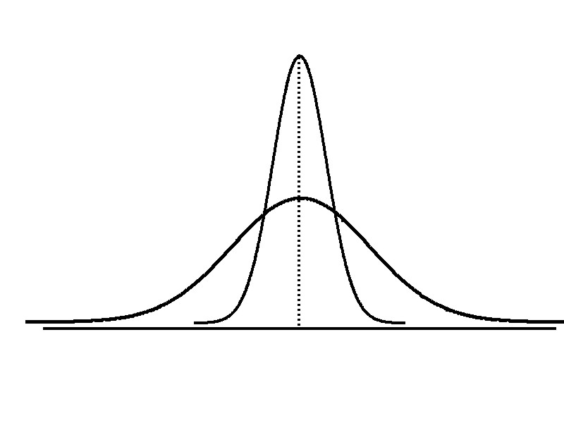
Measures of Variation
DCOVA
Variation
Range
Variance
Standard Deviation
Coefficient of Variation
Measures of variation give information on the spread or variability or dispersion of the data values.
Same center,
different variation
Chap 3-15

Slide 16
Measures of Variation:
The Range
DCOVA
Simplest measure of variation
Difference between the largest and the smallest values:
Range = X_{largest} – X_{smallest}
Example:
0 1 2 3 4 5 6 7 8 9 10 11 12 13 14
Range = 13 - 1 = 12
Chap 3-16

Slide 17
Measures of Variation:
Why The Range Can Be Misleading
DCOVA
Ignores the way in which data are distributed
Sensitive to outliers
7 8 9 10 11 12
7 8 9 10 11 12
Range = 12 - 7 = 5
Range = 12 - 7 = 5
1,1,1,1,1,1,1,1,1,1,1,2,2,2,2,2,2,2,2,3,3,3,3,4,5
Range = 5 - 1 = 4
1,1,1,1,1,1,1,1,1,1,1,2,2,2,2,2,2,2,2,3,3,3,3,4,120
Range = 120 - 1 = 119
Chap 3-17

Slide 18
Measures of Variation:
The Sample Variance
DCOVA
Average (approximately) of squared deviations of values from the mean
  Sample variance:
Where
= arithmetic mean
n = sample size
X_{i} = i^{th} value of the variable X
Chap 3-18

Slide 19
Measures of Variation:
The Sample Standard Deviation
DCOVA
Most commonly used measure of variation
Shows variation about the mean
Is the square root of the variance
Has the same units as the original data
  Sample standard deviation:
Chap 3-19

Slide 20
Measures of Variation:
The Standard Deviation
DCOVA
Steps for Computing Standard Deviation
1. Compute the difference between each value and the mean.
2. Square each difference.
3. Add the squared differences.
4. Divide this total by n-1 to get the sample variance.
5. Take the square root of the sample variance to get the sample standard deviation.
Chap 3-20

Slide 21
Measures of Variation:
Sample Standard Deviation
Calculation Example
DCOVA
Sample
Data (X_{i}) : 10 12 14 15 17 18 18 24
n = 8 Mean = X = 16
A measure of the “average” scatter around the mean
Chap 3-21

Slide 22
Measures of Variation:
Comparing Standard Deviations
DCOVA
Data A
Mean = 15.5
S = 3.338
11 12 13 14 15 16 17 18 19 20 21
Data B
Mean = 15.5
S = 0.926
11 12 13 14 15 16 17 18 19 20 21
Data C
Mean = 15.5
S = 4.570
11 12 13 14 15 16 17 18 19 20 21
Chap 3-22

Slide 23
Measures of Variation:
Comparing Standard Deviations
DCOVA
Smaller standard deviation
Larger standard deviation
Chap 3-23

Slide 24
Measures of Variation:
Summary Characteristics
DCOVA
The more the data are spread out, the greater the range, variance, and standard deviation.
The more the data are concentrated, the smaller the range, variance, and standard deviation.
If the values are all the same (no variation), all these measures will be zero.
None of these measures are ever negative.
Chap 3-24

Slide 25
Measures of Variation:
The Coefficient of Variation
DCOVA
Measures relative variation
Always in percentage (%)
Shows variation relative to mean
Can be used to compare the variability of two or more sets of data measured in different units
Chap 3-25

Slide 26
Measures of Variation:
Comparing Coefficients of Variation
DCOVA
Stock A:
  Average price last year = $50
  Standard deviation = $5
Stock B:
  Average price last year = $100
  Standard deviation = $5
Both stocks have the same standard deviation, but stock B is less variable relative to its price
Chap 3-26

Slide 27
Measures of Variation:
Comparing Coefficients of Variation
(continued)
Stock A:
  Average price last year = $50
  Standard deviation = $5
Stock C:
  Average price last year = $8
  Standard deviation = $2
DCOVA
Stock C has a much smaller standard deviation but a much higher coefficient of variation
Chap 3-27

Slide 28
Locating Extreme Outliers:
Z-Score
DCOVA
To compute the Z-score of a data value, subtract the mean and divide by the standard deviation.
The Z-score is the number of standard deviations a data value is from the mean.
A data value is considered an extreme outlier if its Z-score is less than -3.0 or greater than +3.0.
The larger the absolute value of the Z-score, the farther the data value is from the mean.
Chap 3-28

Slide 29
Locating Extreme Outliers:
Z-Score
DCOVA
where X represents the data value
X is the sample mean
S is the sample standard deviation
Chap 3-29

Slide 30
Locating Extreme Outliers:
Z-Score
DCOVA
Suppose the mean math SAT score is 490, with a standard deviation of 100.
Compute the Z-score for a test score of 620.
A score of 620 is 1.3 standard deviations above the mean and would not be considered an outlier.
Chap 3-30

Slide 31
Shape of a Distribution
DCOVA
Describes how data are distributed
Two useful shape related statistics are:
  Skewness
    Measures the amount of asymmetry in a distribution
  Kurtosis
    Measures the relative concentration of values in the center of a distribution as compared with the tails
Chap 3-31

Slide 32
Shape of a Distribution (Skewness)
DCOVA
Describes the amount of asymmetry in distribution
  Symmetric or skewed
Left-Skewed
Symmetric
Right-Skewed
Mean < Median
Mean = Median
Mean > Median
Skewness
Statistic
< 0 0 >0
Chap 3-32

Slide 33
Shape of a Distribution (Kurtosis)
DCOVA
Describes relative concentration of values in the center as compared to the tails
Flatter Than
Bell-Shaped
Bell-Shaped
Sharper Peak
Than Bell-Shaped
Kurtosis
Statistic
< 0 0 >0
Chap 3-33

Slide 34
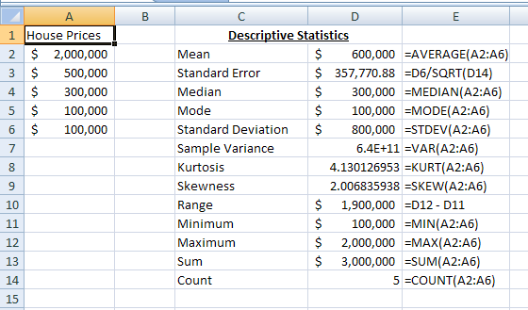
General Descriptive Stats Using Microsoft Excel Functions
DCOVA
Chap 3-34

Slide 35
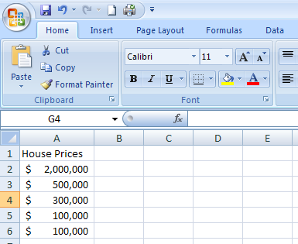
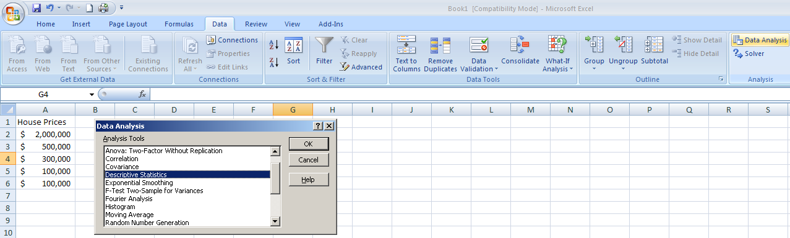
General Descriptive Stats Using Microsoft Excel Data Analysis Tool
DCOVA
Select Data.
Select Data Analysis.
Select Descriptive Statistics and click OK.
Chap 3-35

Slide 36
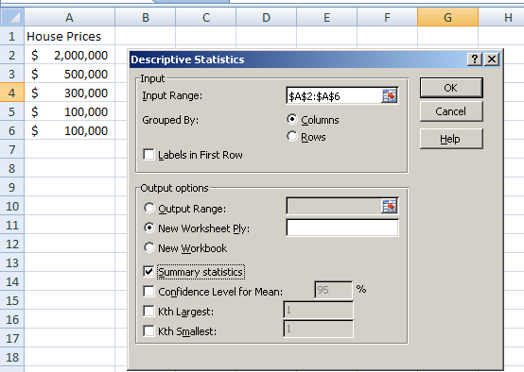
General Descriptive Stats Using Microsoft Excel
DCOVA
4. Enter the cell range.
5. Check the Summary Statistics box.
6. Click OK
Chap 3-36

Slide 37
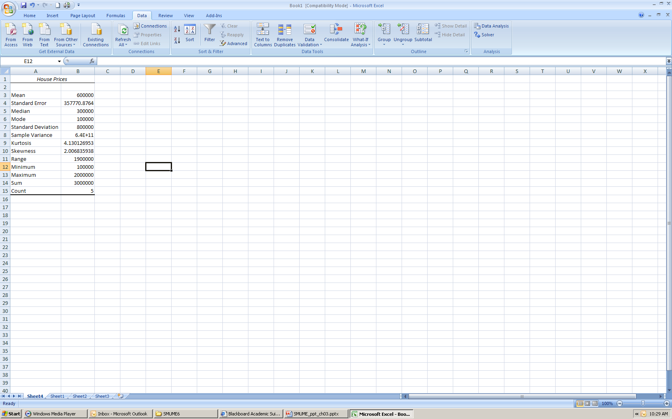
Excel output
DCOVA
Microsoft Excel
descriptive statistics output,
using the house price data:
House Prices:
$2,000,000
500,000
300,000
100,000
100,000
Chap 3-37

Slide 38
Minitab Output
Descriptive Statistics: House Price
Total
Variable Count Mean SE Mean StDev Variance Sum Minimum
House Price 5 600000 357771 800000 6.40000E+11 3000000 100000
N for
Variable Median Maximum Range Mode Skewness Kurtosis
House Price 300000 2000000 1900000 100000 2.01 4.13
Chap 3-38

Slide 39
Quartile Measures
DCOVA
Quartiles split the ranked data into 4 segments with an equal number of values per segment
25%
25%
25%
25%
Q1
Q2
Q3
The first quartile, Q₁, is the value for which 25% of the observations are smaller and 75% are larger
Q₂ is the same as the median (50% of the observations are smaller and 50% are larger)
Only 25% of the observations are greater than the third quartile
Chap 3-39

Slide 40
Quartile Measures:
Locating Quartiles
DCOVA
Find a quartile by determining the value in the appropriate position in the ranked data, where
First quartile position: Q₁ = (n+1)/4 ranked value
Second quartile position: Q₂ = (n+1)/2 ranked value
Third quartile position: Q₃ = 3(n+1)/4 ranked value
where n is the number of observed values
Chap 3-40

Slide 41
Quartile Measures:
Calculation Rules
DCOVA
When calculating the ranked position use the following rules
  If the result is a whole number then it is the ranked position to use
  If the result is a fractional half (e.g. 2.5, 7.5, 8.5, etc.) then average the two corresponding data values.
  If the result is not a whole number or a fractional half then round the result to the nearest integer to find the ranked position.
Chap 3-41

Slide 42
Quartile Measures:
Locating Quartiles
DCOVA
Sample Data in Ordered Array: 11 12 13 16 16 17 18 21 22
(n = 9)
Q₁ is in the (9+1)/4 = 2.5 position of the ranked data
so use the value half way between the 2nd and 3rd values,
so Q₁ = 12.5
Q₁ and Q₃ are measures of non-central location
Q₂ = median, is a measure of central tendency
Chap 3-42

Slide 43
Quartile Measures
Calculating The Quartiles: Example
DCOVA
Sample Data in Ordered Array: 11 12 13 16 16 17 18 21 22
(n = 9)
Q₁ is in the (9+1)/4 = 2.5 position of the ranked data,
so Q₁ = (12+13)/2 = 12.5
Q₂ is in the (9+1)/2 = 5th position of the ranked data,
so Q₂ = median = 16
Q₃ is in the 3(9+1)/4 = 7.5 position of the ranked data,
so Q₃ = (18+21)/2 = 19.5
Q₁ and Q₃ are measures of non-central location
Q₂ = median, is a measure of central tendency
Chap 3-43

Slide 44
Quartile Measures:
The Interquartile Range (IQR)
DCOVA
The IQR is Q₃ – Q₁ and measures the spread in the middle 50% of the data
The IQR is also called the midspread because it covers the middle 50% of the data
The IQR is a measure of variability that is not influenced by outliers or extreme values
Measures like Q₁, Q₃, and IQR that are not influenced by outliers are called resistant measures
Chap 3-44

Slide 45
Calculating The Interquartile Range
DCOVA
Example box plot for:
Median
(Q₂)
X
X
Q₁
Q₃
minimum
maximum
25% 25% 25% 25%
12 30 45 57 70
Interquartile range
= 57 – 30 = 27
Chap 3-45

Slide 46
The Five-Number Summary
DCOVA
The five numbers that help describe the center, spread and shape of data are:
  X_{smallest}
  First Quartile (Q₁)
  Median (Q₂)
  Third Quartile (Q₃)
  X_{largest}
Chap 3-46

Slide 47
Relationships among the five-number summary and distribution shape
DCOVA
Left-Skewed | Symmetric | Right-Skewed
Median – X_{smallest} > X_{largest} – Median | Median – X_{smallest} ≈ X_{largest} – Median | Median – X_{smallest} < X_{largest} – Median
Q₁ – X_{smallest} > X_{largest} – Q₃ | Q₁ – X_{smallest} ≈ X_{largest} – Q₃ | Q₁ – X_{smallest} < X_{largest} – Q₃
Median – Q₁ > Q₃ – Median | Median – Q₁ ≈ Q₃ – Median | Median – Q₁ < Q₃ – Median
Chap 3-47

Slide 48
Five-Number Summary and
The Boxplot
DCOVA
The Boxplot: A Graphical display of the data based on the five-number summary:
X_{smallest} -- Q₁ -- Median -- Q₃ -- X_{largest}
Example:
25% of data 25% 25% 25% of data
of data of data
X_{smallest} Q₁ Median Q₃ X_{largest}
Chap 3-48

Slide 49
Five-Number Summary:
Shape of Boxplots
DCOVA
If data are symmetric around the median then the box and central line are centered between the endpoints
A Boxplot can be shown in either a vertical or horizontal orientation
X_{smallest} Q₁ Median Q₃ X_{largest}
Chap 3-49

Slide 50
Distribution Shape and
The Boxplot
DCOVA
Left-Skewed
Symmetric
Right-Skewed
Q₁
Q₂
Q₃
Q₁
Q₂
Q₃
Q₁
Q₂
Q₃
Chap 3-50

Slide 51
Boxplot Example
DCOVA
Below is a Boxplot for the following data:
0 2 2 2 3 3 4 5 5 9 27
The data are right skewed, as the plot depicts
X_{smallest} Q₁ Q₂ Q₃ X_{largest}
0 2 3 5 27
Chap 3-51

Slide 52
Numerical Descriptive Measures for a Population
DCOVA
Descriptive statistics discussed previously described a sample, not the population.
Summary measures describing a population, called parameters, are denoted with Greek letters.
Important population parameters are the population mean, variance, and standard deviation.
Chap 3-52

Slide 53
Numerical Descriptive Measures for a Population: The mean µ
DCOVA
The population mean is the sum of the values in the population divided by the population size, N
Where
μ = population mean
N = population size
X_{i} = i^{th} value of the variable X
Chap 3-53

Slide 54
Numerical Descriptive Measures For A Population: The Variance σ²
DCOVA
Average of squared deviations of values from the mean
  Population variance:
Where
μ = population mean
N = population size
X_{i} = i^{th} value of the variable X
Chap 3-54

Slide 55
Numerical Descriptive Measures For A Population: The Standard Deviation σ
DCOVA
Most commonly used measure of variation
Shows variation about the mean
Is the square root of the population variance
Has the same units as the original data
  Population standard deviation:
Chap 3-55

Slide 56
Sample statistics versus population parameters
DCOVA
Measure | Population Parameter | Sample Statistic
Mean
Variance
Standard Deviation
Chap 3-56

Slide 57
The Empirical Rule
DCOVA
The empirical rule approximates the variation of data in a bell-shaped distribution
Approximately 68% of the data in a bell shaped distribution is within ± one standard deviation of the mean or
68%
Chap 3-57

Slide 58
The Empirical Rule
DCOVA
Approximately 95% of the data in a bell-shaped distribution lies within ± two standard deviations of the mean, or µ ± 2σ
Approximately 99.7% of the data in a bell-shaped distribution lies within ± three standard deviations of the mean, or µ ± 3σ
95%
99.7%
Chap 3-58

Slide 59
Using the Empirical Rule
DCOVA
Suppose that the variable Math SAT scores is bell-shaped with a mean of 500 and a standard deviation of 90. Then,
  68% of all test takers scored between 410 and 590 (500 ± 90).
  95% of all test takers scored between 320 and 680 (500 ± 180).
  99.7% of all test takers scored between 230 and 770 (500 ± 270).
Chap 3-59

Slide 60
Chebyshev Rule
DCOVA
Regardless of how the data are distributed, at least (1 - 1/k²) x 100% of the values will fall within k standard deviations of the mean (for k > 1)
  Examples:
(1 - 1/2²) x 100% = 75% …........ k=2 (μ ± 2σ)
(1 - 1/3²) x 100% = 89% ………. k=3 (μ ± 3σ)
At least
within
Chap 3-60

Slide 61
The Covariance
DCOVA
The covariance measures the strength of the linear relationship between two numerical variables (X & Y)
The sample covariance:
Only concerned with the strength of the relationship
No causal effect is implied
Chap 3-61

Slide 62
Interpreting Covariance
DCOVA
Covariance between two variables:
cov(X,Y) > 0 X and Y tend to move in the same direction
cov(X,Y) < 0 X and Y tend to move in opposite directions
cov(X,Y) = 0 X and Y are independent
The covariance has a major flaw:
  It is not possible to determine the relative strength of the relationship from the size of the covariance
Chap 3-62

Slide 63
Coefficient of Correlation
DCOVA
Measures the relative strength of the linear relationship between two numerical variables
Sample coefficient of correlation:
where
Chap 3-63

Slide 64
Features of the
Coefficient of Correlation
DCOVA
The population coefficient of correlation is referred as ρ.
The sample coefficient of correlation is referred to as r.
Either ρ or r have the following features:
  Unit free
  Ranges between –1 and 1
  The closer to –1, the stronger the negative linear relationship
  The closer to 1, the stronger the positive linear relationship
  The closer to 0, the weaker the linear relationship
Chap 3-64

Slide 65
Scatter Plots of Sample Data with Various Coefficients of Correlation
DCOVA
Y
Y
X
X
r = -1
r = -.6
Y
Y
Y
X
X
X
r = +1
r = +.3
r = 0
Chap 3-65

Slide 66
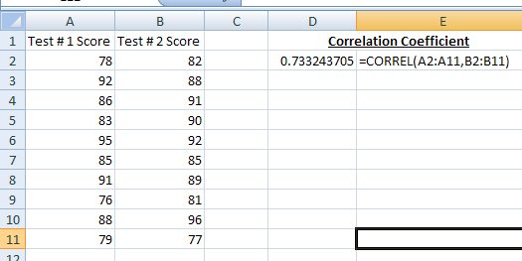
The Coefficient of Correlation Using Microsoft Excel Function
DCOVA
Chap 3-66

Slide 67
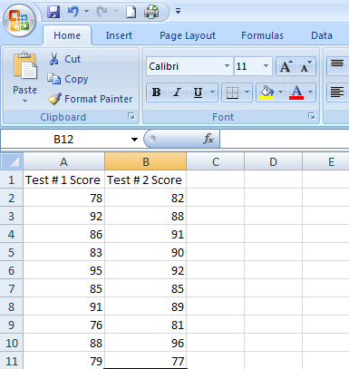
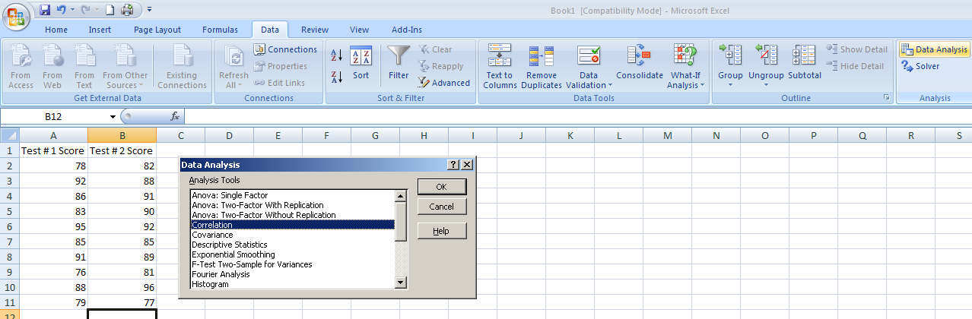
The Coefficient of Correlation Using Microsoft Excel Data Analysis Tool
DCOVA
Select Data
Choose Data Analysis
Choose Correlation & Click OK
Chap 3-67

Slide 68
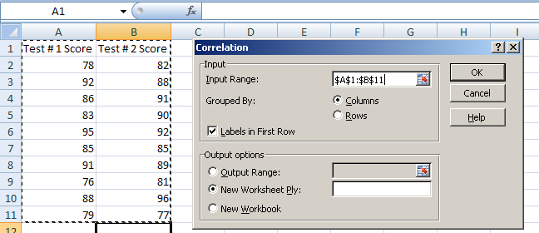
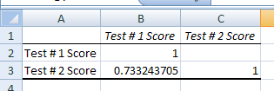
The Coefficient of Correlation
Using Microsoft Excel
DCOVA
Input data range and select appropriate options
Click OK to get output
Chap 3-68

Slide 69
Interpreting the Coefficient of Correlation
Using Microsoft Excel
DCOVA
r = .733
There is a relatively strong positive linear relationship between test score #1 and test score #2.
Students who scored high on the first test tended to score high on second test.
Chap 3-69

Slide 70
Pitfalls in Numerical
Descriptive Measures
DCOVA
Data analysis is objective
  Should report the summary measures that best describe and communicate the important aspects of the data set
Data interpretation is subjective
  Should be done in fair, neutral and clear manner
Chap 3-70

Slide 71
Ethical Considerations
DCOVA
Numerical descriptive measures:
Should document both good and bad results
Should be presented in a fair, objective and neutral manner
Should not use inappropriate summary measures to distort facts
Chap 3-71

Slide 72
Chapter Summary
Described measures of central tendency
  Mean, median, mode, geometric mean
Described measures of variation
  Range, interquartile range, variance and standard deviation, coefficient of variation, Z-scores
Illustrated shape of distribution
  Skewness & Kurtosis
Described data using the 5-number summary
  Boxplots
Chap 3-72

Slide 73
Chapter Summary
(continued)
Discussed covariance and correlation coefficient
Addressed pitfalls in numerical descriptive measures and ethical considerations
Chap 3-73

